Slide 1
DONE BY: PRAGATHI , PRAKRUTHI RAMYA , SUBHASHREE
MICROSERVICES

Slide 2
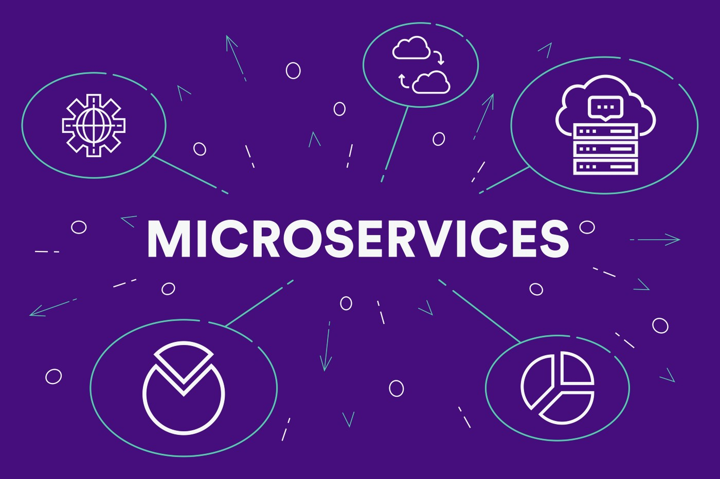
INTRODUCTION
The microservice architectural style is an approach to developing a single application as a suite of small services, each running in its own process and communicating with lightweight mechanisms, often an HTTP resource API.

Slide 3
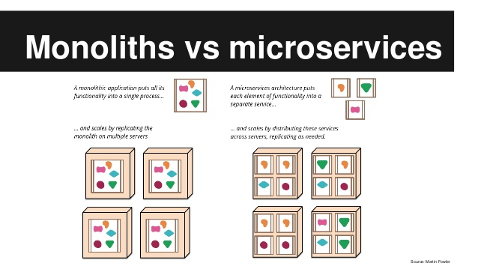
DIFFERENCES BETWEEN MICROSERVICES AND MONOLITHIC ARCHITECTURES

Slide 4
MICROSERVICES
Microservices architecture is built as small independent modules based on business functionality
Each service can be built and deployed independently.There is rapid and continuous deployment
Each project and module has their own database
MONOLITHIC
Monolithic architecture is built as one large system and is usually one code-base
Requires re-creating and re-deploying entire application.Very slow deployment speeds
It has shared database

Slide 5
MICROSERVICES
It is easy to scale based on demand.
Easy to change technology or framework because every module and project is independent
Communicates via API layer with lightweight protocols like REST
MONOLITHIC
It is not easy to scale based on demand
It is extremely difficult to change technology or language or framework because everything is tightly coupled and depend on each other
Communicates by Language-level or procedure calls

Slide 6
CHARACTERISTICS OF MICROSERVICES

Slide 7
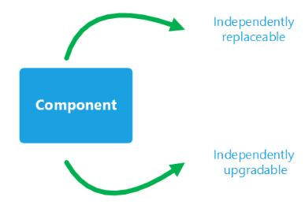
COMPONENTIZATION VIA SERVICES
Microservice architectures use libraries, but their main way of componentizing their own software is by breaking down into services.

Slide 8
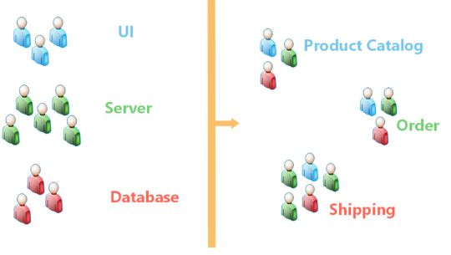
ORGANIZED AROUND BUSINESS CAPABILITIES
A lot of the development organizations are organized around technologies. There is a team for UI, a team for Database and team for Business Logic.
The key thing about the microservices world is to organize around business capabilities rather than technologies. Each team should have some elements that directly impact end user experience.

Slide 9
PRODUCTS NOT PROJECTS
Project model : Deliver some piece of software which is then considered to be completed.
Product model : A team should own a product over its lifetime.

Slide 10
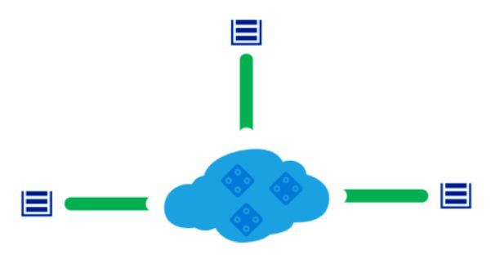
SMART ENDPOINTS AND DUMB PIPES
Enterprise Service Bus (ESB)

Slide 11
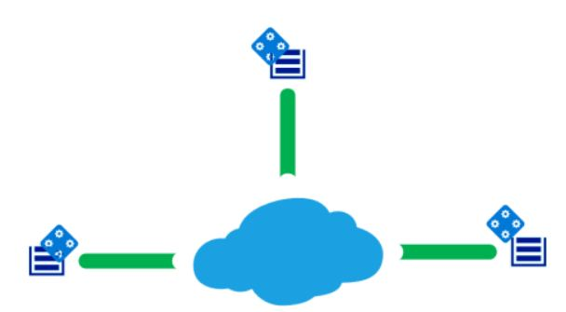
SMART ENDPOINTS AND DUMB PIPES
Microservice community rejects this idea, and they suggest moving all the processing logic to the end point themselves. All we want is a dumb set of pipes to route the messages.

Slide 12
DECENTRALIZED GOVERNANCE
In centralized governance, there is a tendency to standardise on single technology platforms.
Hence in microservices we have a choice of choosing a right tool for a particular service.

Slide 13
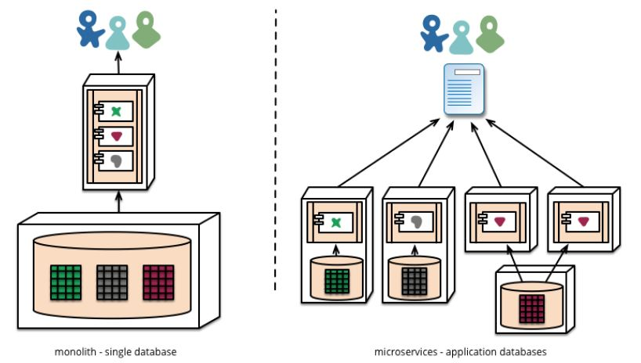
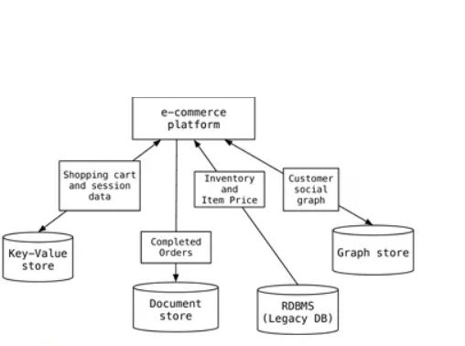
DECENTRALIZED DATA MANAGEMENT
Microservices prefer letting each service manage its own database whereas in monolith we have a centralized database.
Polyglot Persistence is the concept of using different data storage technologies to handle different data storage needs within a software application.

Slide 14
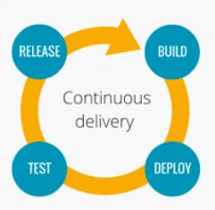
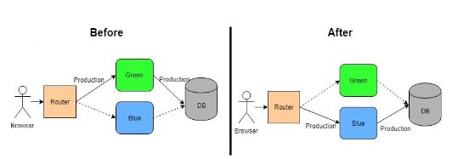
CONTINUOUS DELIVERY
Things like continuous delivery or blue/green deployment where we can deploy with zero downtime are mandatory for microservice to be successful.
Microservices uses cross-functional teams to handle the entire life cycle of an application using a continuous delivery model. When developers, operations, and testing teams work simultaneously on a single service, testing and debugging becomes easy and instant. With this approach of incremental development, code is continuously developed, tested and deployed, and can use code from existing libraries instead of reinventing the wheel.

Slide 15
DESIGN FOR FAILURE
Traditional approaches often equate reliability with preventing failure. When we have several services deployed on multiple nodes, chances are some of them are going to fail. So we need to design the services with failure in mind. That’s why monitoring should be an integral part of the microservice architecture.
Eg:Netflix's Simian Army
Microservice applications put a lot of emphasis on real-time monitoring of the application, checking both architectural elements (how many requests per second is the database getting) and business relevant metrics (such as how many orders per minute are received).

Slide 16

EVOLUTIONARY DESIGN
With a monolith architecture any changes require a full build and deployment of the entire application.
With microservices we only need to redeploy the service(s) modified. This can simplify and speed up the release process.
Eg:Guardian website

Slide 17

EXAMPLE
We’ll be understanding microservices by taking Netflix as an example. Overall, Netflix has around 700 microservices. We’ll be going through the important few.

Slide 18
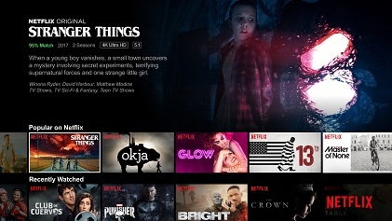
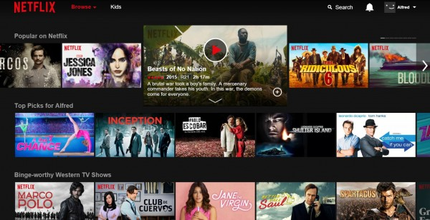

Slide 19
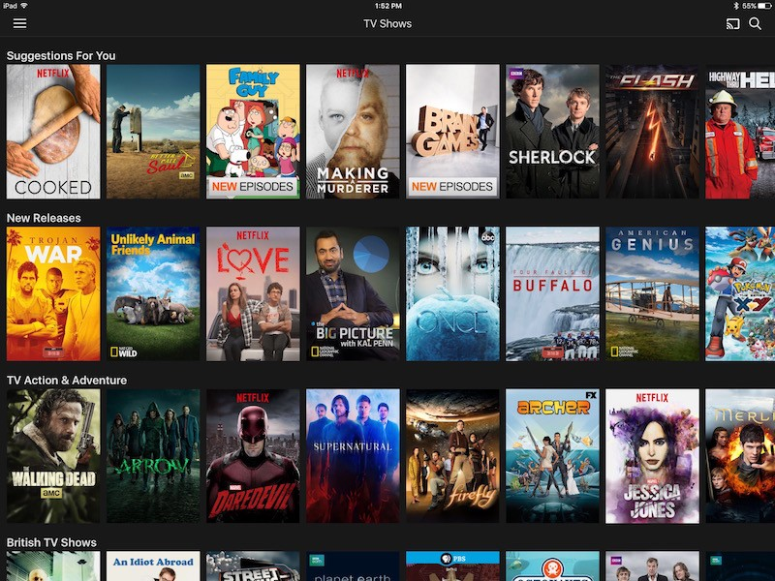
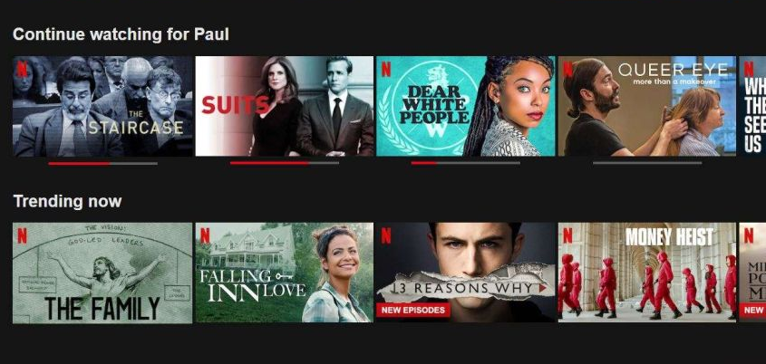

Slide 20
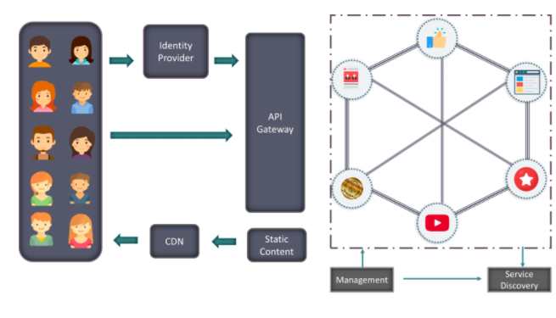

Slide 21

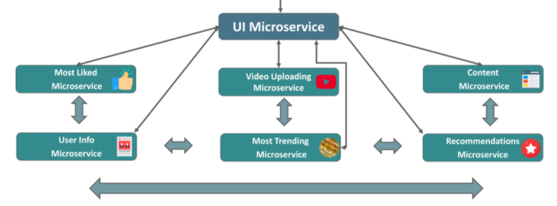

Slide 22
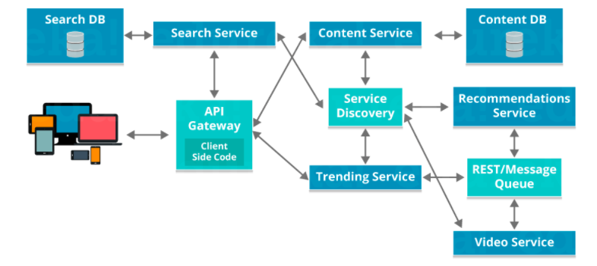

Slide 23
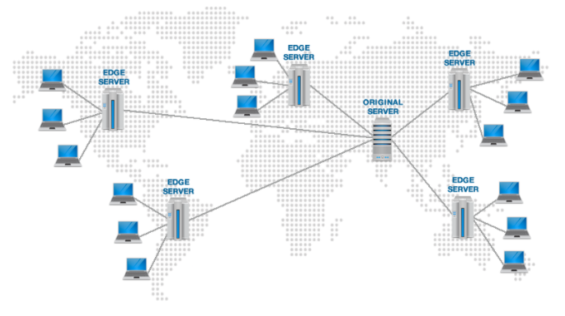

Slide 24
LINKS IN ORDER TO EXPLORE MORE
https://martinfowler.com/articles/microservices.html
https://tomyrhymond.wordpress.com/2017/03/15/microservices/
https://www.guru99.com/microservices-tutorial.html
https://www.tutorialspoint.com/difference-between-monlithic-and-microservices-architecture

Slide 25
THANK YOU

